Slide 1
Forestry Budget Updates
Council on Forestry
March 23, 2018
Mike Warnke
Forestry Deputy Division Administrator

Slide 2
Forestry Account Audit
An audit of the Forestry Account and the funding for forestry related expenditures could:
Review trends in overall revenues, expenditures, and staffing levels
Analyze detailed program expenditures, including staffing costs, to determine the extent to which the Forestry Account’s funds are used for purposes that are entirely forestry related, as well as for purposes that benefit programs in addition to forestry, or which do not benefit the forestry program; and
Determine DNR’s compliance with applicable requirements governing the allocation and use of forestry related funding

Slide 3
Forestry Account Audit
Kick off on January 8, 2018
Led By LAB-Expectations
Anticipated Completion 06/30/2018
Requests: 2013-2017 FY’s
Expenditure data, Activity code handbooks, Payroll data, Condition statements, starting to meet staff to learn more about roles and the “work”
All things still appear to be on track.

Slide 4
Budget Discussion -Expenditures
GPR- Formula Driven Revenue to the account
Governor: Specify that, beginning in fiscal year 2017-18, and annually each year thereafter, an amount equal to 0.1697 mills for each dollar of the assessed valuation of the property in the state be transferred from the general fund to the conservation fund for the purpose of acquiring, preserving and developing the forests of the state and for other specified forestry purposes. Create a sum-sufficient GPR appropriation for the transfer and specify that the transfer amounts may be paid at intervals during each fiscal year as deemed necessary by the DOA Secretary.
Current Projections show an increase of 3%/year*
*Subject to DOR actual calculations
Approximately $88.8M FY 18

Slide 5
Budget Discussion -Expenditures
Conservation Paper 60, page 29
What is an expenditure?
  Definition- the authorized spending, disbursement or consumption of taxpayer money.
Where is the authorization? WI statutes Chapter 20 and other directive statutes and Acts.
How is an expenditure made? Acts & statutes ultimately define and refer to an appropriation.

Slide 6
Budget Discussion -Expenditures
It’s all about the Law and Appropriation!
Appropriations in general- appropriations shall become effective on July 1 of the fiscal year and shall be expendable until the following June 30. If the legislature does not amend or eliminate any existing appropriation on or before July 1 of the odd-numbered years, such existing appropriations provided for the previous fiscal year shall be in effect in the new fiscal year and all subsequent fiscal years until amended or eliminated by the legislature.

Slide 7
Budget Discussion -Expenditures
Appropriations: Generally Five types
Annual- are appropriations which are expendable only “up to” the amount shown in the schedule and only for the fiscal year for which made.
Biennial- are appropriations which are expendable only for the biennium for which made.
Continuous- are appropriations which are expendable until fully depleted or repealed by subsequent action of the legislature.

Slide 8
Budget Discussion -Expenditures
Appropriations Generally Five types (Continued):
Sum Sufficient- Sum sufficient appropriations are appropriations which are expendable from the indicated source in the amounts necessary to accomplish the purpose specified. Dollar amounts shown represent the most reliable estimate of the amounts which will be needed.
Capital Improvements-are authorizations to contract public debt in accordance with ch. 18 (Stewardship for example)

Slide 9
Budget Discussion -Expenditures
Forestry Account BIG picture
Division of Forestry Operations Approximately $52 million/year (48%)
Others (approximately $62M/year)(52%)
  DNR split funded appropriations = $20 million
  Southern State Forest operations = $5.5 million
  Knowles-Nelson Stewardship Program debt service = $13.5 million
  Aids in Lieu of Taxes = $6 million
  Other agencies (DATCP, State Historical Society, UW System, Kickapoo Reserve Management Board, Lower Wisconsin State Riverway Board) = $2.7 million

Slide 10
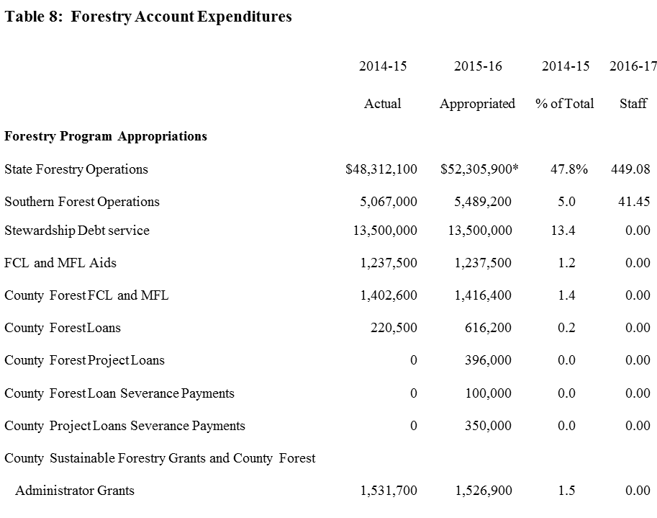
Budget Discussion -Expenditures

Slide 11
Budget Discussion -Expenditures
Let's get in to the details (kind of)
County Forest FCL and MFL $1,416,400….AKA
  Ch 20.370 5(bv) Resource Aids- CF, FCL & MFL $1,416,400 (in the “schedule” 20.005)
The Details
  5(bv) Resource aids — county forests, forest croplands and managed forest land aids. A sum sufficient to pay county forest aids under s. 28.11 (8) (a), forest croplands aids under subch. I of ch. 77 and managed forest land aids under ss. 77.85 and 77.89 (1) (a).

Slide 12
Budget Discussion -Expenditures
And More Details!
The County Forest Piece
  28.11(8)(a)(a) Acreage payments. As soon after April 20 of each year as feasible, the department shall pay to each town treasurer 30 cents per acre, based on the acreage of such lands as of the preceding June 30, as a grant out of the appropriation made by s. 20.370 (5) (bv) on each acre of county lands entered under this section (28.10 County Forests).

Slide 13
Budget Discussion -Expenditures
And More Details!
The Forest Crop Law Piece
  77.05 State contribution. The department of natural resources shall pay before June 30 annually to the town treasurer, from the appropriation under s. 20.370 (5) (bv), 20 cents for each acre of land in the town that is described as forest croplands under this subchapter.

Slide 14
Budget Discussion -Expenditures
And More Details!
The Managed Forest Law Piece
  77.85 State contribution. The department shall pay before June 30 annually the municipal treasurer, from the appropriation under s. 20.370 (5) (bv), 20 cents for each acre of land in the municipality that is designated as managed forest land under this subchapter and for each acre of land in the municipality that has been withdrawn under s. 77.885 but for which payments under s. 77.84 (2) are being made.

Slide 15
Budget Discussion -Expenditures
And More Details!
The Appropriation
  Ch 20.370 5(bv) Resource Aids- CF, FCL & MFL $1,416,400
  AKA - Appropriation 571 (Wismart) or 57100 (Peoplesoft)
FISC_YEAR | FUND | APPR_UNIT | PS_FUND | PS_APPR | APPR_NAME | BUDGET_AUTH_AMT_9 | ENCUMBERED_AMT_9 | EXPENDED_AMT_9
2015 | 212 | 5716 | 21200 | 57100 | RESOURCE AIDS -- COUNTY FOREST | $ 1,416,400.00 | 0 | $ 1,402,647.02

Slide 16
Budget Discussion -Expenditures
And More Details!
The Appropriation (571)
  Ch 20.370 5(bv) Resource Aids- CF, FCL & MFL $1,416,400
  The three pieces!
Aids to Municipalities Payments:
MFL @ $0.20/acre | $662,596 | $665,680 | $669,733
FCL @ $0.20/acre | $26,522 | $25,169 | $22,773
CFL @ $0.30/acre | $713,529 | $714,053 | $717,613
Total Payments | $1,402,647 | $1,404,902 | $1,410,119
Appropriated Amount (20.370 (5) (bv)) | $1,416,400 | $1,416,400 | $1,416,400

Slide 17
Budget Discussion -Expenditures
Summary
All expenditures must be appropriated
Only the legislature can appropriate money
The appropriation defines the nature in which money can be expended
The amounts that are appropriated are found in the schedule in Ch. 20.

Slide 18
Budget Discussion -Expenditures
Summary
The Division of Forestry has limited discretion in expending money. This lies in the Forestry Operations appropriation 20.370 2(mv). Within this appropriation, excluding the “must pay bills (salary, fringe, rent, utilities ~$45Million)” About 2.5% “discretionary” .
Of course it must still be in line with the law!
20.370 2(mv)-…relate to the management and protection of the state's forestry resources

Slide 19
Thank You!
Questions?

